Slide 1





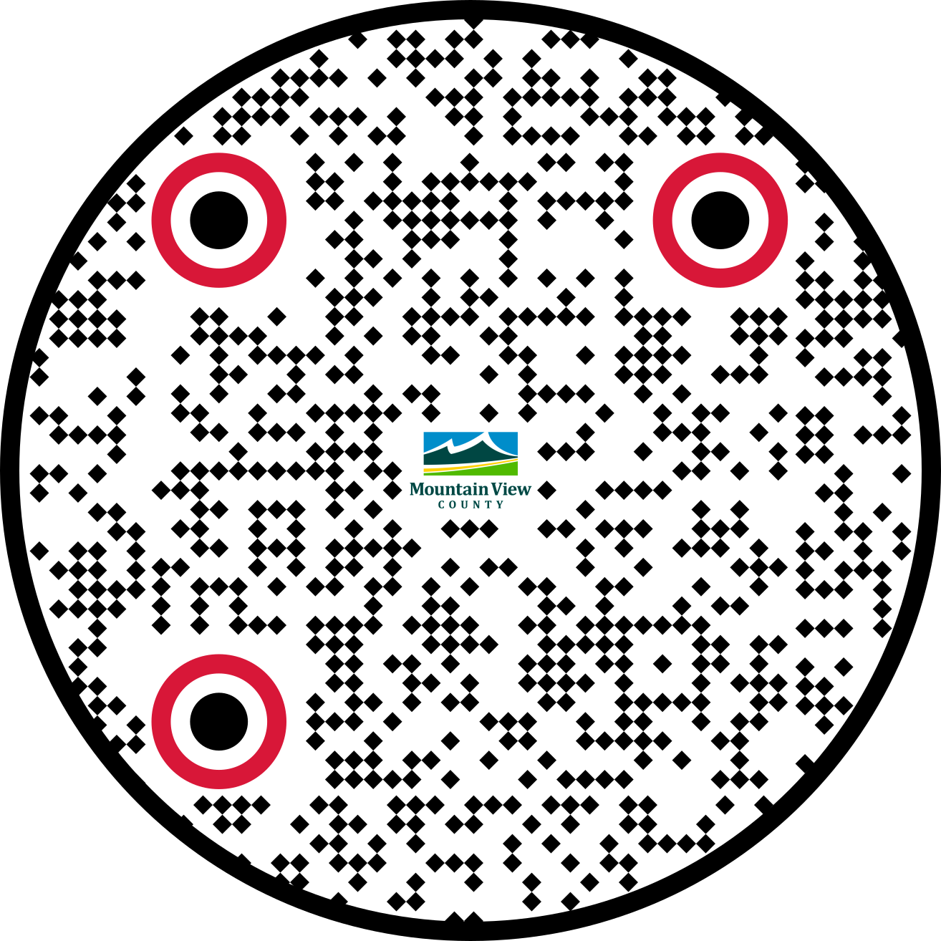
Information on Land Use Plans and Policies
WHAT IS LAND USE MANAGEMENT?
Agriculture is the backbone of the County and finding ways to preserve farmland is paramount. Land Use Management aims to balance development and growth pressures with environmental, social and economic considerations, while limiting cumulative effects.
MUNICIPAL GOVERNMENT ACT
The Act outlines the powers of municipalities and the planning documents that municipalities prepare
WHAT ARE CUMULATIVE EFFECTS?
The combined impacts from past and present development and land use activities
WE’RE HERE TO HELP!
The staff at Mountain View County are available to assist with any questions you have. Contact us today!
Visit the Planning & Development Website or Scan the QR Code below
MOUNTAIN VIEW COUNTY POLICY DOCUMENTS
There are four types of document used for land use planning:
Intermunicipal Development Plan (IDP)
  Policy documents for areas of the County that border with other municipalities
  Aims to identify suitable land uses where boundaries are shared and where there are shared interests
  Approved through Council by all participating municipalities
Municipal Development Plan (MDP)
  Policy document with the high-level policies for the entire County
Area Structure Plan (ASP)
  Policy document with more detailed policies for a specific area of the County
Land Use Bylaw (LUB)
  Provides the regulations for development and defines the various land use districts (zoning)
Each of the Plans must go through a public consultation process before they can be adopted by Council.

Slide 2
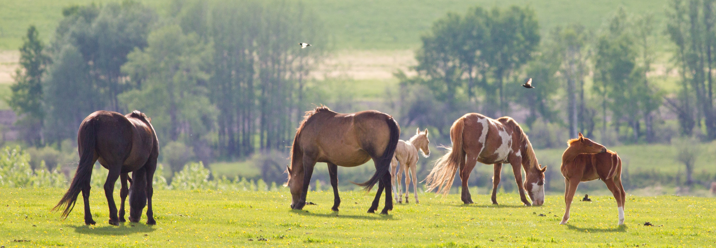
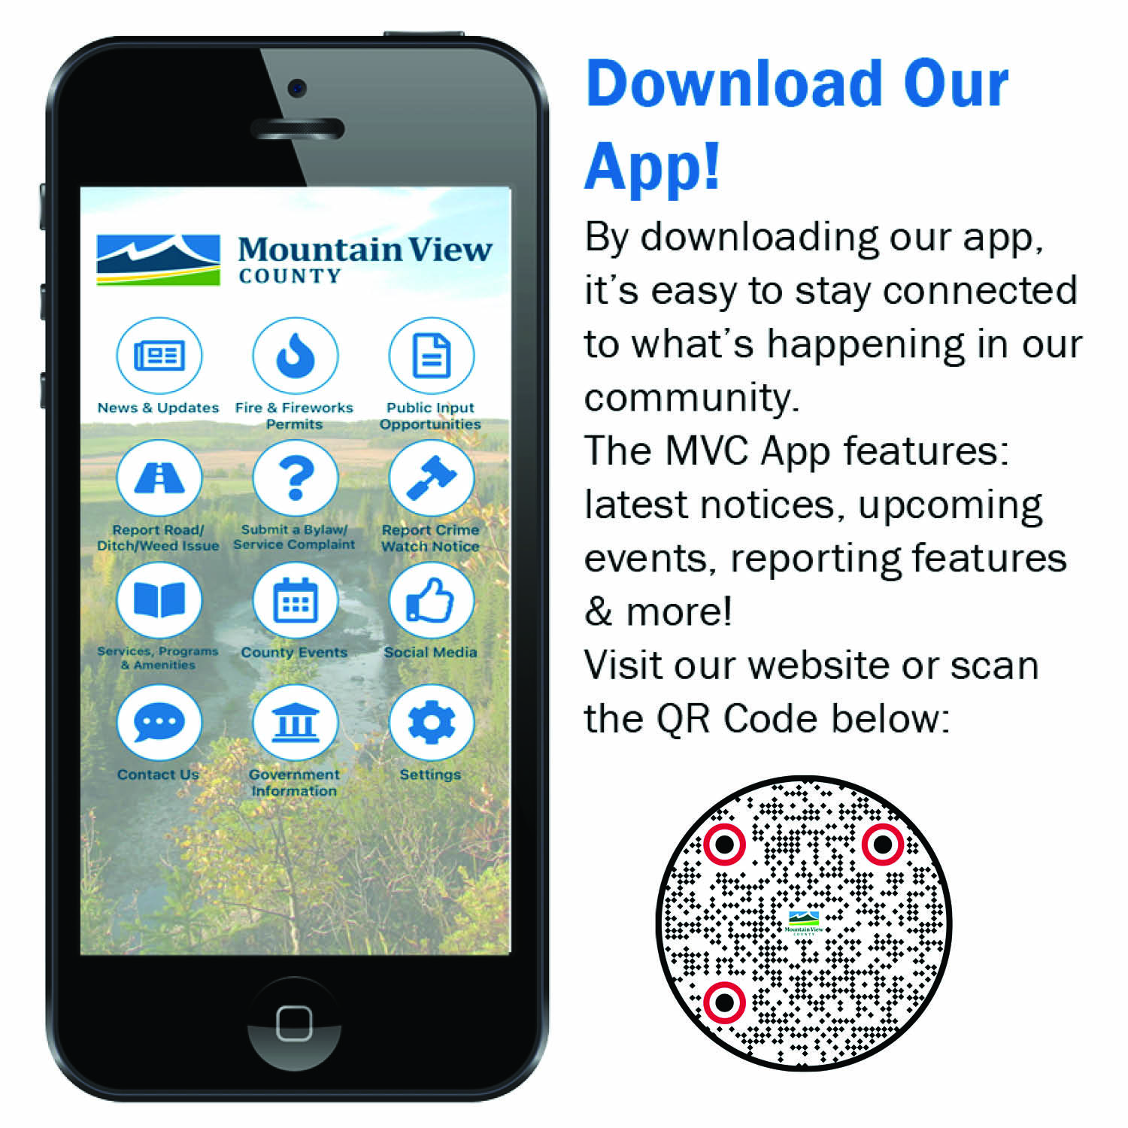





INTERMUNICIPAL DEVELOPMENT PLANS (IDPS)
There are six IDPs with the County’s neighbouring municipalities:
Town of Carstairs
Village of Cremona
Town of Didsbury
Town of Olds
Town of Sundre
MD of Bighorn
AREA STRUCTURE PLANS (ASP)
There are nine ASPs for specific areas of the County:
Bearberry / Red Deer River Corridor ASP
Bergen ASP
Eagle Valley ASP
East Didsbury ASP
Olds-Didsbury Airport ASP
SE Sundre ASP
South Carstairs ASP
South McDougal Flats ASP
Water Valley-Winchell Lake ASP
PLANNING HIERARCHY
The Municipal Government Act (Section 638) states that if conflict or inconsistency arise between statutory plans the higher statutory plan(s) prevail.
Municipal Government Act (MGA)
Alberta Land Stewardship Act (ALSA)
Historical Resources Act
Provincial Land Use Policies
ALSA Regional Plan
Alberta Register of Historic Places
Intermunicipal Development Plans (IDPs)
Municipal Development Plan (MDP)
Area Structure Plans (ASPs)
Area Redevelopment Plans (ARPs)
Land Use Bylaw
(LUB)
Subdivision & Development Regulation
GET THE INFORMATION YOU NEED:
10 - 1408 - Twp Rd 320
Postal Bag 100
Didsbury, AB T0M 0W0
Main: 403-335-3311
Fax: 403-335-9207
Toll Free: 1-877-264-9754
www.mountainviewcounty.com
GET SOCIAL WITH US:
Facebook.com/MVCounty
@Mountain_View_County
@MVCounty
@MountainViewCounty349

